Slide 1

Data Analysis & Visualization for FDA
SQL & Power BI Analysis
By Madhumita Chakraborty

Slide 2
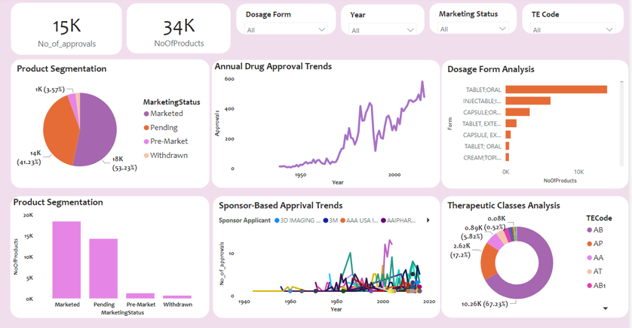
Introduction & Objectives
Your Objectives
FDA intends to carryout analysis of data gathered over the years for approval of drugs in the United Stated of America. The will help identify the trends of drug approval process and other related details
Key Objectives
Approach
Identifying approval trends over time
Objectives & requirements understanding
Data overview and cleansing
Identification of analysis flow
Applying tools (Power BI and SQL)
Generating results
Analyzing product segmentation based on marketing status
Evaluating drug categories by dosage form
Analysis and Charts
Exploring therapeutic classes and their approval trends

Slide 3
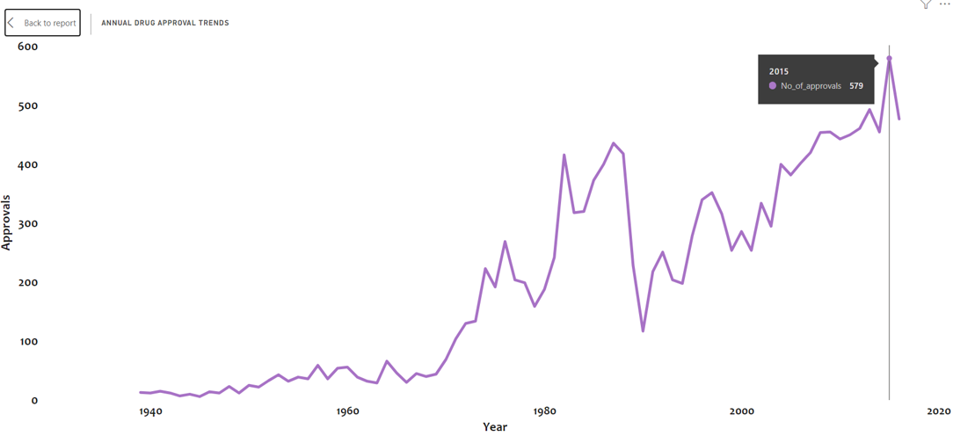
Annual Drug Approval Trends
Yearly Drug Approval Trends
Key Insights
Over the years the general trend of drug approval has been increasing with few sudden rise and upsets in between
Year 1980s and post 1990s the trend has been on the rise for approvals
The biggest increase was in year 1980 after a drop in year 1979 and the biggest increase in approval number. However the drop was also sudden in 1990s with gradual increase till 2020. Notably the approval count has drop again after 2020 which could be due to COVID 19.

Slide 4
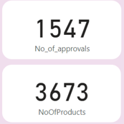
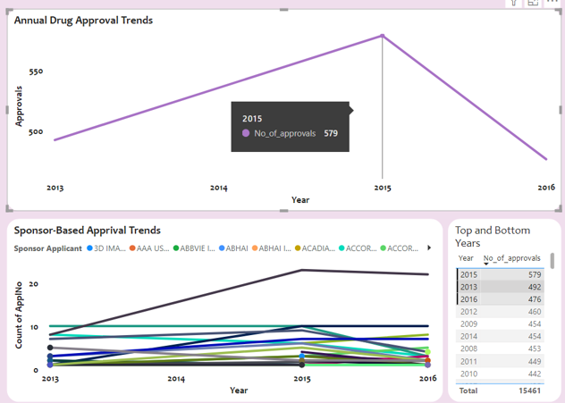
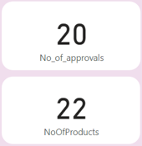
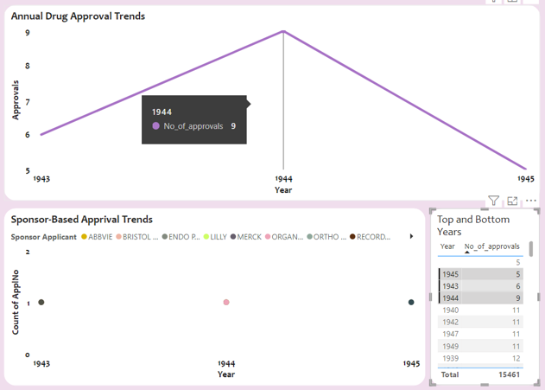
Top and Bottom Approval Years
Highest and Lowest Approval Years
Key Insights
The highest number of approvals so far was in year 2015 and the it decrease the year after that. That was followed by Year 2013 and 2016.
Year 1945 had lowest number of approvals with just 5 approvals and subsequent gradual increase in approvals every year
The key products and drugs Vs Approval ratios should be noted in each century and evaluated for pattern recognition

Slide 5
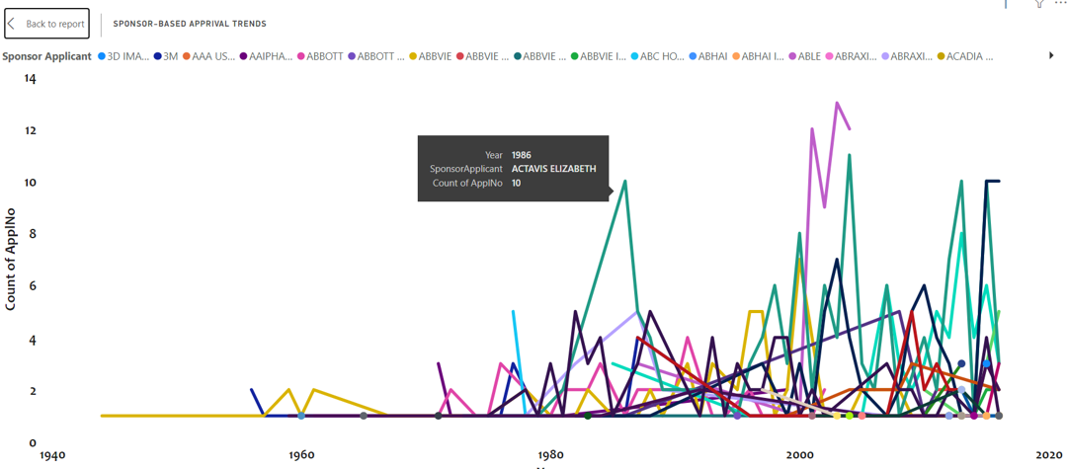
Sponsor-Based Approval Trends
Approval Trends by Sponsors
Key Insights
While the trend in no of applications from each sponsor has been varied over the years, ACTAVIS ELIZABETH has remained on the higher side. Specially in 1996 with 10 applications
Another sponsor – ABLE has been in the fore front post 2000 with ACTAVIS
Highest number of applications has been in year 2000, 2001, 1996 and post 2010.

Slide 6
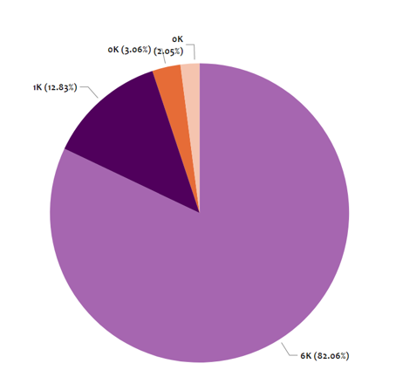
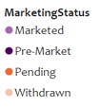
Marketing Status Segmentation
Product Segmentation by Marketing Status
Key Insights
More than 80% of the products are in the Marketed segment
There are close to 2% of products that are still there which are withdrawn from the Marketing
The second largest segment of products are pre-marketed as well.

Slide 7
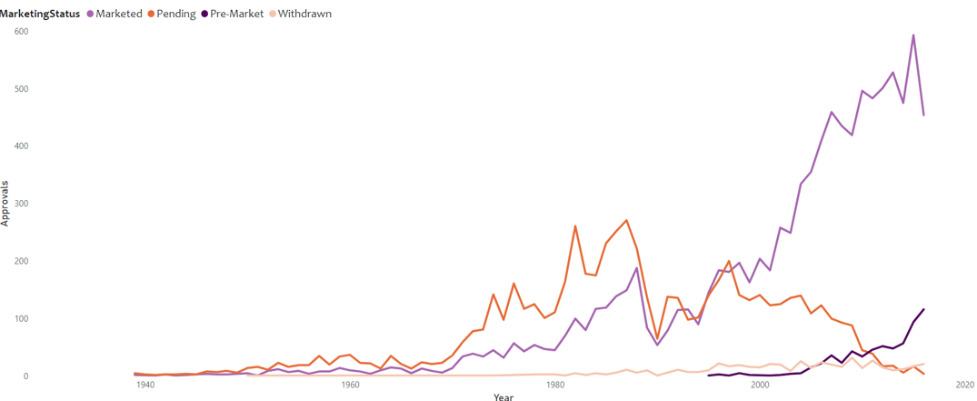
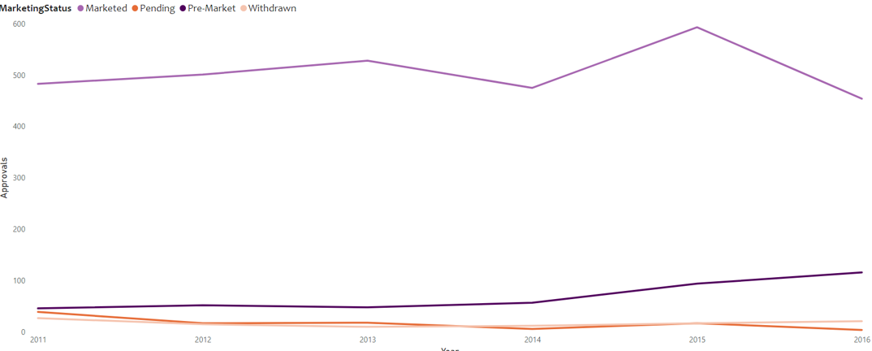
Marketing Status Segmentation
Marketing Status trends
Key Insights
The trend for marketed products has increase and largely from later 1990s and early 2000’s. The same has increase suddenly post 2000
The sudden increase in marketed products is due to introduction of premarket stage only late 1900s and early 2000s.
The pending and withdrawals has been the lower side except from year 1970 to 1985s

Slide 8
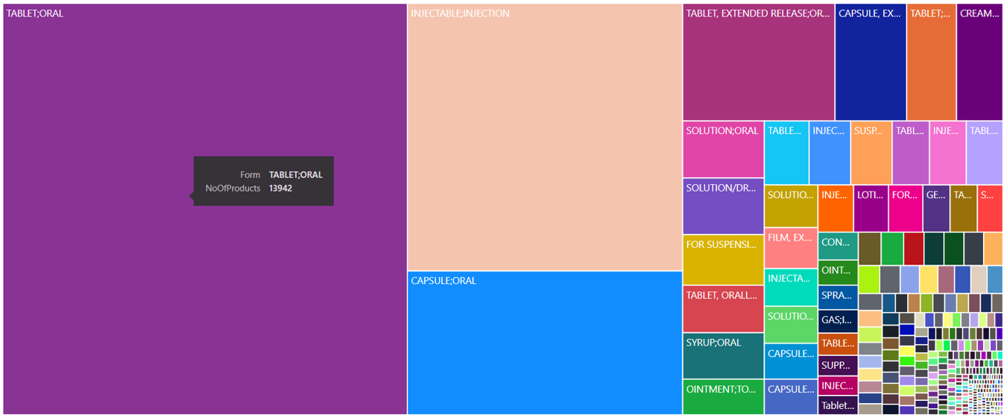
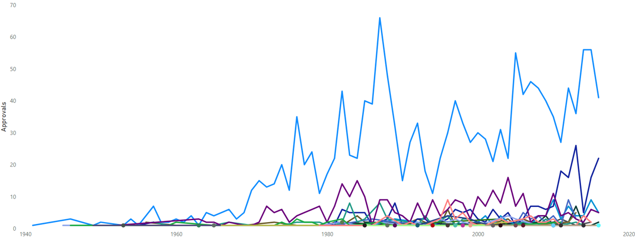
Dosage Form Analysis
Distribution of Drug Approval by Dosage Form
Key Insights
The top three dosage forms has been tablet – oral, Injectable-injections & Capsule –Orals respectively
However the larger number of approvals are for Capsule Oral going up to 70 over the years.
The trend for overall approvals is consistent with the dosage form also

Slide 9
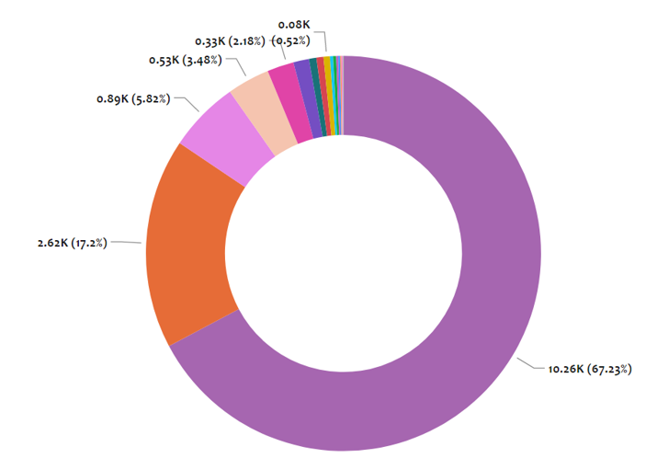
Therapeutic Classes Analysis
Drug Approval by Therapeutic Classes
Key Insights
The highest approval rates are for AB and AB1 Type of TE Codes
AB takes the majority of portion of approval with more than 65% of approvals

Slide 10
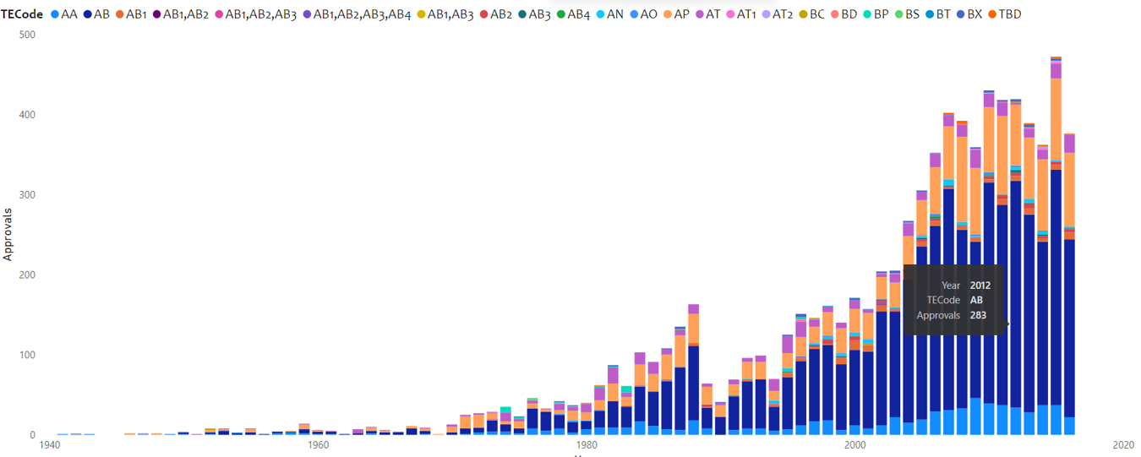
Therapeutic Classes Analysis
Drug Approval by Therapeutic Classes
Key Insights
Over the period the AB and AP has remained on top for approvals in terms of therapeutic classes
One notable trend is that AP’s popularity for approval as increase drastically and likely to match with AB over next few years

Slide 11
Summary and Insights
Summary
Out of total 15,000 approval for 34,000 products over last 90 years, the approval trends has been on the rise except few major exceptions in year 1990 and 1980.
After the introduction of pre-marketed stage, the product marketed status has increased drastically with lesser % of products being withdrawn or pending
The focus should be on reducing the number of products being in pending status
The AB, AP and AA are top three therapeutic classes in terms of popularity
FDA should focus on increasing more resources in products with dosage type Tablet, Injections and Capsules in order to ensure efficient approvals

Slide 12

THANK YOU

